Slide 1
Lesson 3: Random Forest and Gradient Boosted Trees

Slide 2
Today's Agenda
Decision/Regression tree bagging
Random forest regression/classification
Gradient boosting regression/classification

Slide 3
Learning Objectives
By the end of this session, you should be able to:
Describe bootstrap and why bootstrap helps.
Demonstrate how bootstrap aggregation works for classification/regression trees.
Apply random forest and gradient boosting trees to data sets and evaluate performance.

Slide 4
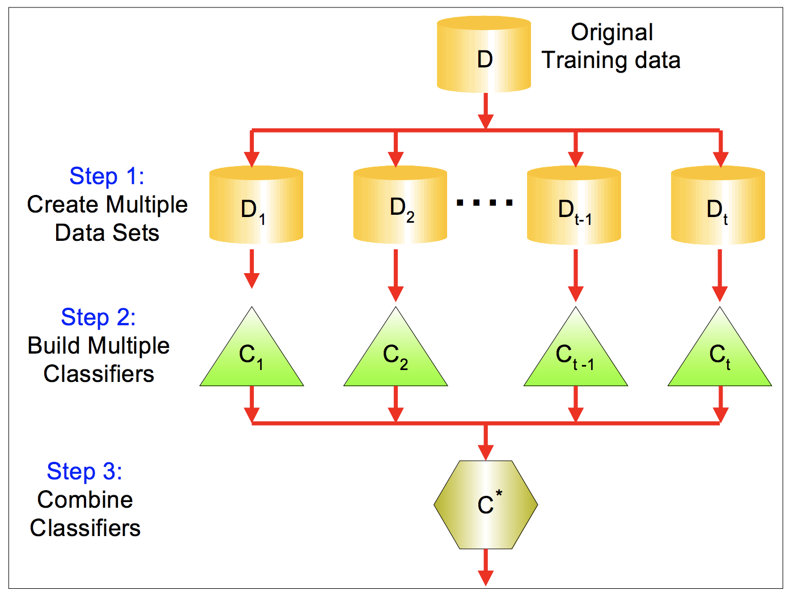
Bagging
Bootstrap aggregation, or bagging, is a general-purpose procedure for reducing the variance of a machine learning method by combining the result of multiple classifiers trained on different sub-samples of the same data set.
E.g. random forest.
Bagging:
Step 1: Create bootstrap samples (sample with replacement).
Step 2: Train separate classifier on each sample.
Step 3: Classify new data point by majority vote or average.

Slide 5
Random Forest (Decision Forests)
Ensemble of multiple independently trained decision trees
Each tree is trained using a sample of observations and a sample of independent variables
Think about three doctors diagnosing heart disease. One doctor is trained by just looking at ECG, one doctor is a Chinese medicine doctor who is trained only by only touching the pulse, and one doctor is trained by looking at the ultrasound image
Each doctor is trained on data of different patients (there might be overlapping among the sets of patients)

Slide 6
Random Forest (Decision Forests)
Advantages of Random Forest:
Significantly better performance than individual trees
Automatic Feature Selection
Less risk of overfitting
Can be parallelized easily (training of multiple doctors can happen at the same time independently)
Disadvantages:
Less interpretability than decision trees
In some algorithms, data is copied in order to train each tree. Has higher requirement in memory space than individual trees.

Slide 7
Random Forest (Decision Forests)
Combination of decision trees and bagging concepts
A large number of decision trees is trained, each on a different bagging sample
At each split, only a random number of the original variables is available (i.e. small selection of columns)
Data points are classified by majority voting of the individual trees

Slide 8
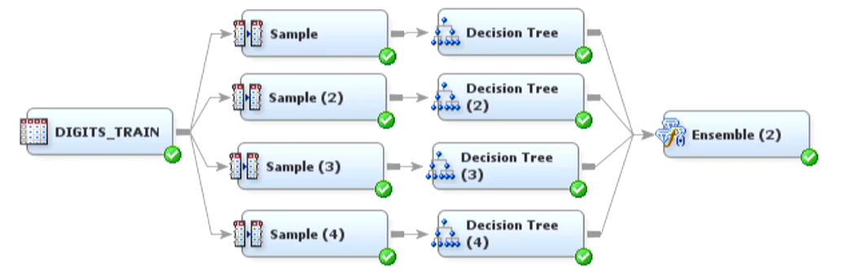
Random Forest (Decision Forests)

Slide 9
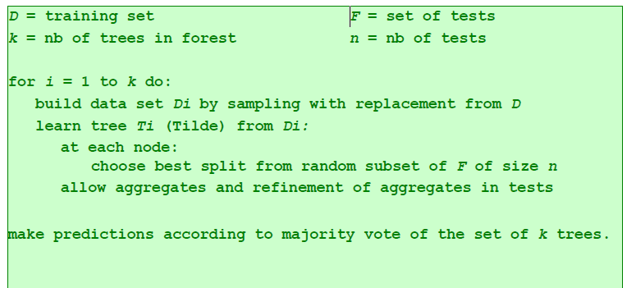
Random Forest (Decision Forests)

Slide 10
Random Forest Classifier
Training Data
M features
N examples

Slide 11
Random Forest Classifier
Create bagging samples
from the training data
M features
N examples
....…

Slide 12
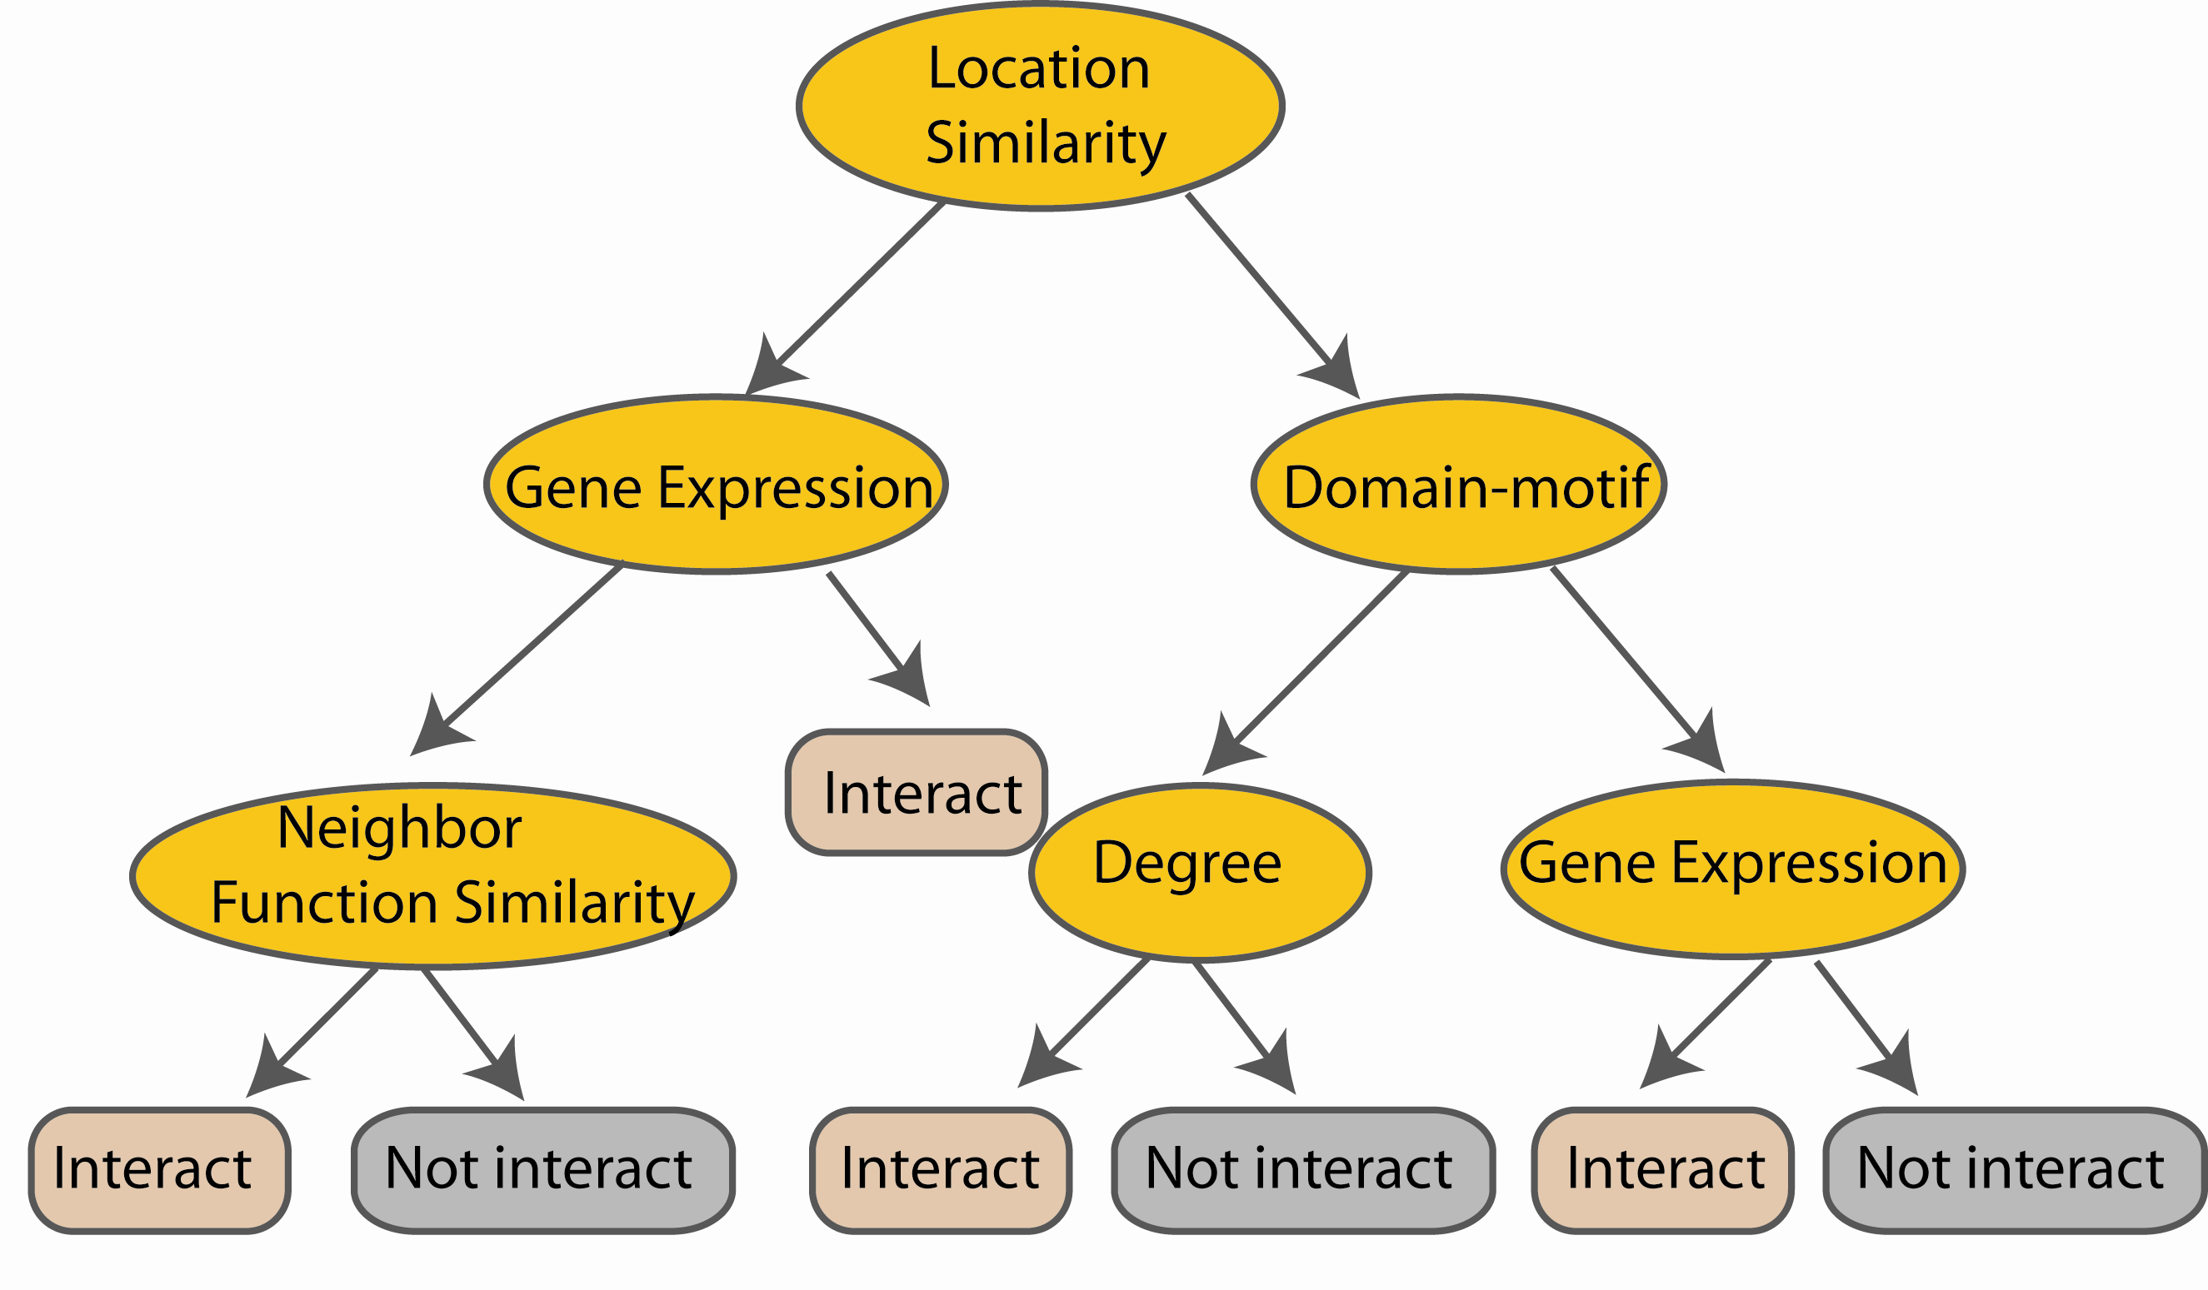
Random Forest Classifier
Construct a decision tree
M features
N examples
....…

Slide 13

Random Forest Classifier
At each node in choosing the split feature
choose only among m<M features
M features
N examples
....…

Slide 14

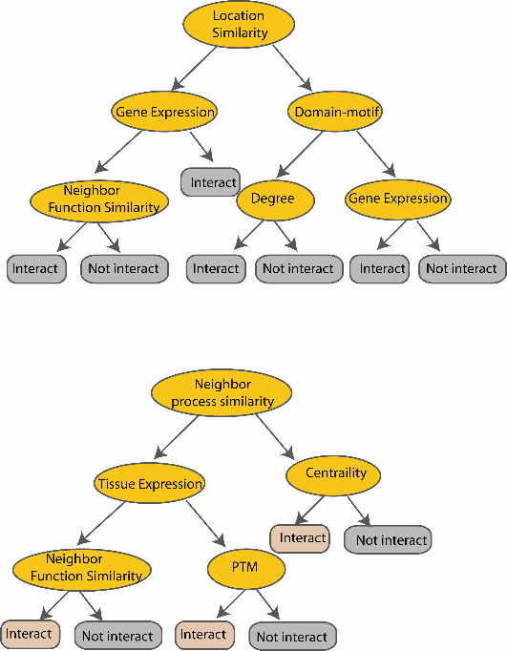
Random Forest Classifier
Create decision tree
from each bootstrap sample
M features
N examples
....…
....…

Slide 15
Random Forest Classifier
M features
N examples
Take the majority vote
....…
....…

Slide 16
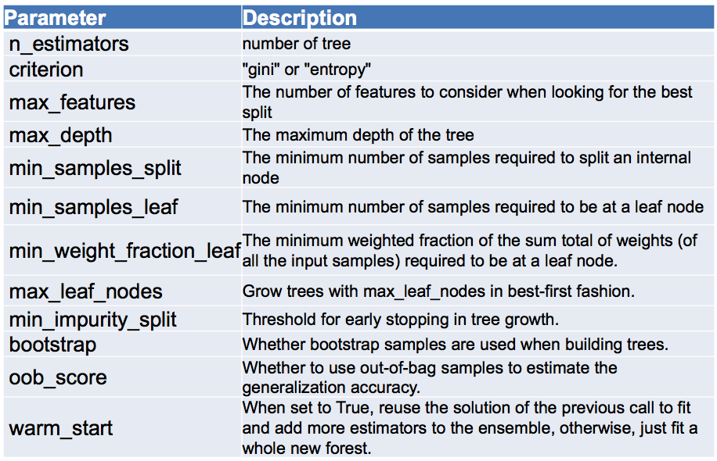
Random Forest options in Scikit-learn

Slide 17
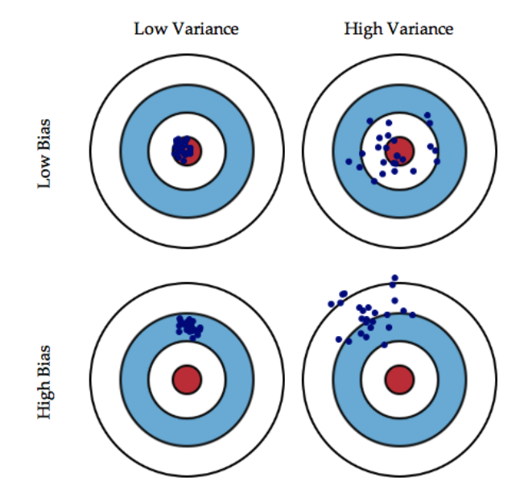
Bias/Variance Tradeoff
ERORR = BIAS + VARIANCE + NOISE
Bias: the difference between the predicted value and the actual value.
Model underfits the training data and fails to capture the underlying pattern within the data.
e.g. Linear model
Variance: the variability of a model prediction for a given data point.
Learning is not stable. A small change in the training data or hyper-parameter can lead to a very different model/predictoin.
E.g. decision tree

Slide 18
Bagging: reduces variance – Example 1
Two categories of samples: blue, red
Two predictors: x1 and x2
Diagonal separation…hardest case for tree-based classifier
Single tree decision boundary in orange.
Bagged predictor decision boundary in red.

Slide 19
Bagging: reduces variance – Example 2
Ellipsoid separation →
Two categories,
Two predictors
Single tree decision boundary
100 bagged trees..

Slide 20
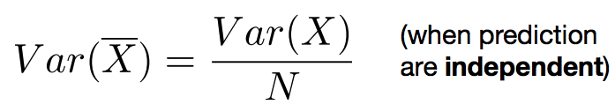
Why does bagging work?
Bagging reduces variance by averaging the predictions from multiple classifiers.
Bagging has little effect on bias.
Can we average and reduce both bias and variance?
Yes: Boosting

Slide 21
Boosting

Slide 22
Main Idea of Boosting
Learn classifiers in sequence: later classifiers focus on examples that were misclassified by earlier classifiers.
Weighted voting: weight the predictions of the classifiers according their prediction accuracy.

Slide 23
Boosting Realization
On each iteration t:
Weight each training example by how incorrectly it was classified by previous classifiers.
increasing the weight of incorrectly classified examples ensures that they will become more important in the next iteration.
Learn a classifier h_{t}(x) based on the weighted training data.
Calculate a strength factor ⍺_{t} for h_{t}(x) based on its accuracy.
Final classifier:
Weighted voting of different classifiers where weight is their strength factor.

Slide 24
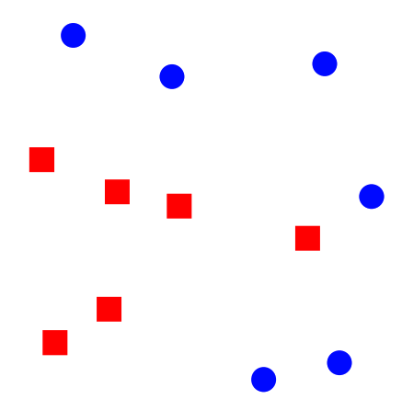
Boosting Intuition
Goal: turn weak learners (e.g. linear model) into a strong learner.
Pick a weak linear classifier h_{t}(x).
Adjust weights: misclassified examples get heavier weight.
Calculate strength ⍺_{t} according to the weighted error of h_{t}(x).

Slide 25
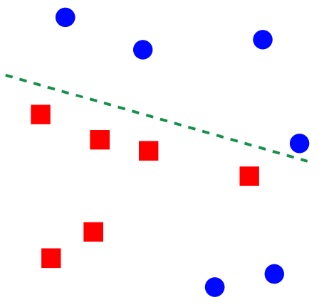
Boosting Intuition
Goal: turn weak learners (e.g. linear model) into a strong learner.
Pick a weak linear classifier h_{t}(x).
Adjust weights: misclassified examples get heavier weight.
Calculate strength ⍺_{t} according to the weighted error of h_{t}(x).

Slide 26
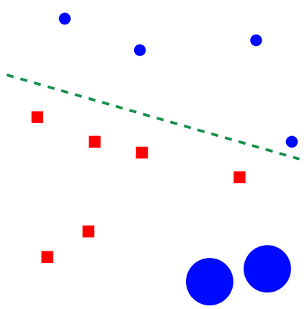
Boosting Intuition
Goal: turn weak learners (e.g. linear model) into a strong learner.
Pick a weak linear classifier h_{t}(x).
Adjust weights: misclassified examples get heavier weight.
Calculate strength ⍺_{t} according to the weighted error of h_{t}(x).

Slide 27
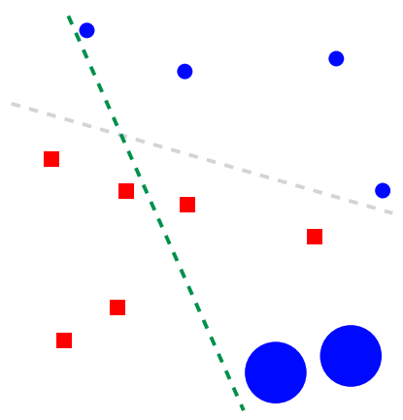
Boosting Intuition
Goal: turn weak learners (e.g. linear model) into a strong learner.
Pick a weak linear classifier h_{t}(x).
Adjust weights: misclassified examples get heavier weight.
Calculate strength ⍺_{t} according to the weighted error of h_{t}(x).

Slide 28
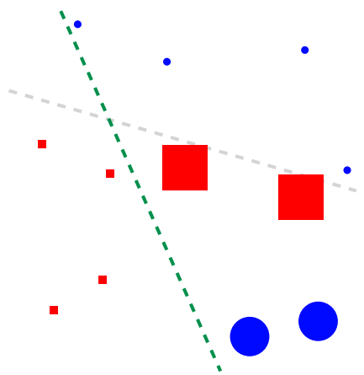
Boosting Intuition
Goal: turn weak learners (e.g. linear model) into a strong learner.
Pick a weak linear classifier h_{t}(x).
Adjust weights: misclassified examples get heavier weight.
Calculate strength ⍺_{t} according to the weighted error of h_{t}(x).

Slide 29

Boosting Intuition
Goal: turn weak learners (e.g. linear model) into a strong learner.
Pick a weak linear classifier h_{t}(x).
Adjust weights: misclassified examples get heavier weight.
Calculate strength ⍺_{t} according to the weighted error of h_{t}(x).

Slide 30
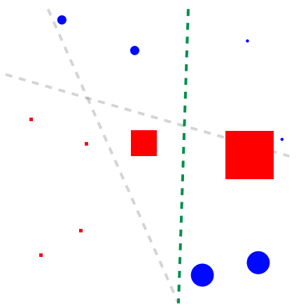
Boosting Intuition
Goal: turn weak learners (e.g. linear model) into a strong learner.
Pick a weak linear classifier h_{t}(x).
Adjust weights: misclassified examples get heavier weight.
Calculate strength ⍺_{t} according to the weighted error of h_{t}(x).

Slide 31
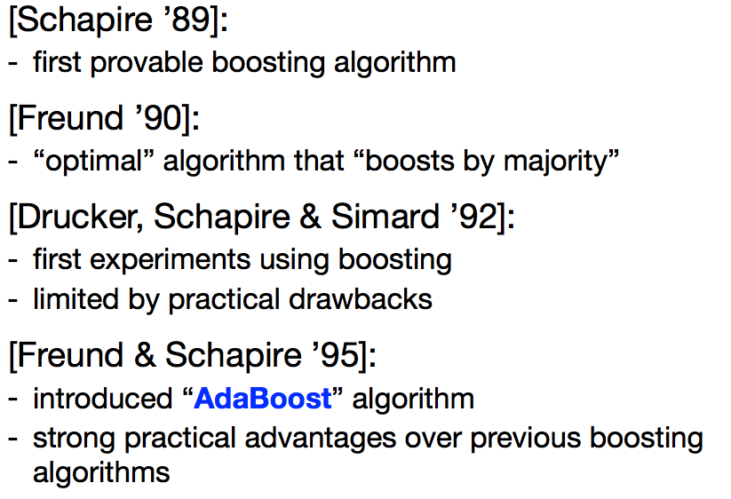
Boosting history

Slide 32
AdaBoost

Slide 33
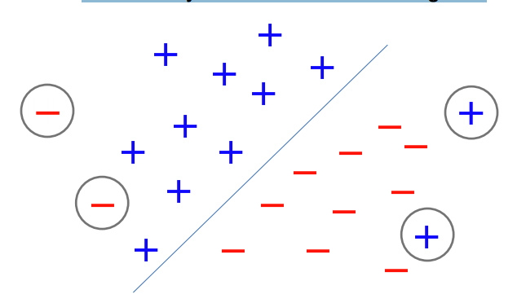
Effect of Outliers
Too many outliers can degrade classification performance dramatically increase time to convergence.

Slide 34
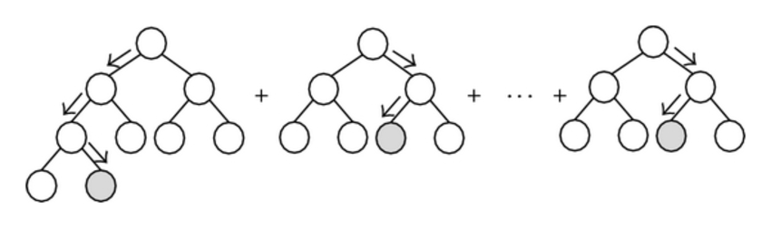
Gradient Boost Decision Trees
Adaboost: redistribute the weights in the data so that later classifier focuses more on the misclassified examples by previous classifiers.
Gradient boosting:
Step 1: Calculate the residual for all examples in the training data (the difference between the outcome of the first learner and the real value).
Step 2: Build learner to predict/fit the residual left from the previous classifiers.
These two steps continues until certain threshold is met.

Slide 35
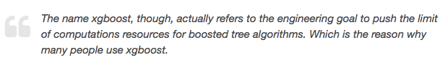
XGBoost
XGBoost stands for eXtreme Gradient Boosting.
XGBoost is an implementation of gradient boosted decision trees, created by Tianqi Chen (UW).
The two advantages of XGBoost:
Execution Speed (written in C++).
Model Performance (a more regularized model formalization to control over-fitting).

Slide 36
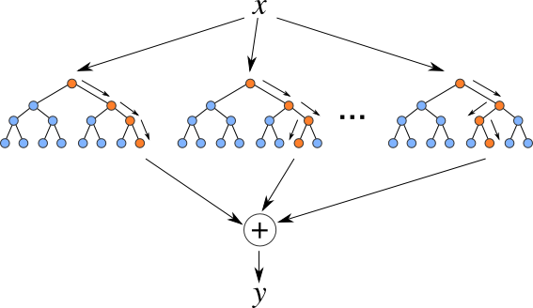
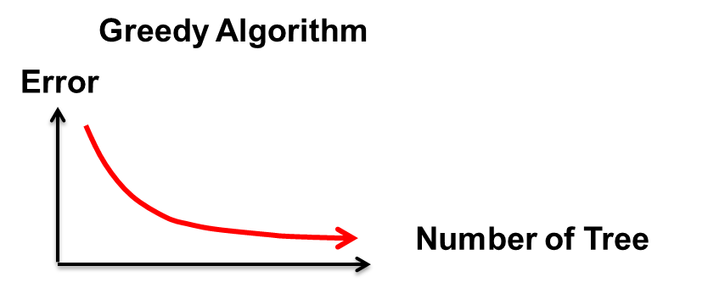
XGBoost
Additive tree model: add new trees that complement the already-built ones
Response is the optimal linear combination of all decision trees
Image courtesy of Sha Li

Slide 37
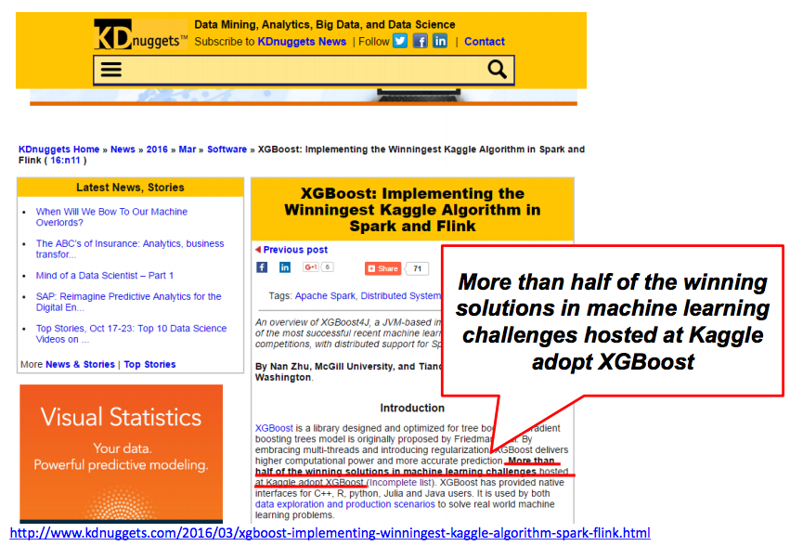
XGBoost Occupied Kaggle

Slide 38
XGBoost Resources
The original paper: https://arxiv.org/abs/1603.02754
Github repo: https://github.com/dmlc/xgboost

Slide 39
Boosting: Pros and Cons
Pros:
Often best off-the-shelf accuracy on many problems.
Using model for prediction requires only modest memory and is fast.
Does not require careful normalization of features to perform well.
Like decision trees, handles a mixture of feature types.
Cons:
The models are often difficult for humans to interpret.
Requires careful tuning of the learning rate and other parameters.
Not easy to parallel (unlike random forest) since each classifier can only be trained after the previous one has been trained.

Slide 40
Bagging vs. Boosting
Bagging:
Resamples data points
Weight of each classifier is the same
Only variance reduction
Boosting:
Reweights data points
Weight is dependent on classifier’s accuracy.
Both bias and variance reduced.

